Slide 1
Customer Churn Prediction and Reduction
(Using Lean Six Sigma (DMAIC) and Machine Learning)
ISE 250 – Leading Six Sigma Improvement Final Project
Utsha Bhattacharjee Siddhi Kitawat Meera Shah Romika Singh Lakshmi Durga Davuluri
Professor: Behin Elahi Date: 28 - Apr - 2026

Slide 2
Introduction: Customer Churn in Telecom
Customer churn occurs when a customer cancels their telecom service and switches to a competitor. It is one of the most critical and costly challenges facing the telecom industry today.
🌐 Telecom Context
💰 Revenue Impact
📊 Our Dataset
Highest annual churn rate of any major sector — over 30% globally
Low switching costs, High competition, Similar service pricing
Losing a customer costs 6–7x more than retaining one
5% churn reduction = 25–95% profit increase
Avg churned bill: $75.21/month
1,336 churned = $100,000+ monthly loss
IBM Telco Customer Churn Dataset
5,043 real customers
25 variables incl. Tenure_Group & Charges_Group
Demographics, services, billing
Target: Churn = Yes / No
Source: Kaggle (free & public)
The telecom industry loses billions annually due to churn. Our project uses Six Sigma DMAIC + Machine Learning to predict and reduce it.

Slide 3
Literature Review
Machine Learning
Lean Six Sigma (DMAIC)
Machine learning models such as Logistic Regression, Decision Trees, and Random Forest are widely used for churn prediction - (Huang, Mohand, Brian 2012)
Studies show these models help identify customers who are likely to churn in advance - (Neslin et al., 2006)
Advanced techniques like XGBoost and Deep Learning further improve prediction performance - (Chen & Guestrin, 2016; Zhao et al., 2017)
Feature analysis reveals key churn drivers such as contract type, tenure, and monthly charges - (Verbeke et al., 2012)
Proper data preprocessing (handling missing values and imbalances) is required to make telecom models reliable - (Ibrahim AlShourbaji, 2024)
In Telecom, a "defect" is defined as a customer cancellation. Six Sigma helps define the specific financial loss per churned user - (Bhargava et al. 2010)
You must measure the current "Yield" (retained customers). Most Telecoms operate at a 2.0 to 3.0 Sigma level before improvement - (Ghelani 2023)
Root cause analysis often reveals that technical support delays are the #1 driver of churn in broadband services. (Sarrosh et al, 2018)
"Lean" focuses on removing non-value-added steps in the billing process to prevent "Bill Shock," which causes immediate churn - (Abdullah 2022)
Use P-Charts (Attribute Control Charts) to monitor the proportion of churned customers monthly to ensure the process stays "In Control - (Mehdi Imani, 2024)
ML enables accurate prediction of customer churn and supports proactive retention strategies
DMAIC enables systematic improvement of processes that directly impact customer retention
Combining both: ML identifies high-risk customers, while DMAIC fixes underlying issues. This integration creates a data-driven and structured approach to churn reduction.

Slide 4
DMAIC Framework
Control 📈
Improve ⚙️
Monitor performance
Analyze 🧠
Apply retention strategies
Measure 📊
Find drivers + predict churn
Define 🔍
Calculate key metrics
Identify churn problem
Structured approach to predict and reduce churn

Slide 5
Define Phase: Problem Statement & Project Charter
Churn Rate
Customers Lost
Sigma Level
DPMO
26.5%
1,336
2.12 σ
264,922
Project Charter
SIPOC Diagram
Problem:
26.5% churn — 1,336 of 5,043 customers lost
S
Suppliers:
Telecom company
Goal:
Reduce churn to below 10% using DMAIC
I
Inputs:
Contracts, billing, services
Sigma:
Current 2.12 → Target 2.78+
P
Process:
Service delivery + support
Scope:
Cleaned IBM Telco dataset — 5,043 customers, 25 variables
O
Outputs:
Customer stays or churns
C
Customers:
Telecom subscribers
Churn Rate (%) = (1,336 / 5,043) × 100 = 26.5% | DPMO = (1,336 ÷ 5,043) × 1,000,000 = 264,922 |
Sigma Level = 0.8406 + √(29.37 − 2.221 ln(264,922)) = 2.12
Churn Rate (%) = (1,336 / 5,043) × 100 = 26.5% | DPMO = (1,336 ÷ 5,043) × 1,000,000 = 264,922 |
Sigma Level = 0.8406 + √(29.37 − 2.221 ln(264,922)) = 2.12

Slide 6
Define Phase: Voice of Customer & CTQ Tree
Voice of Customer (VOC)
CTQ Tree — Critical to Quality
✅ Customers WANT
Y = Churn (Yes / No) — Our Target Variable
Affordable transparent pricing
Reliable internet with no outages
Flexible contracts — no lock-in
Responsive tech support
X1
Contract Type
Month-to-month: 43.1% | 2-yr: 2.4%
X2
Tenure Group
0–12 months: 47.8% — highest risk
❌ Customers LEAVE Because
X3
Monthly Charges
High monthly bills ($75.21 avg for churned)
Month-to-month contracts — no incentive to stay
No tech support included in plan
Electronic check payment — low auto-commitment
Poor onboarding in first 12 months (47.8% churn)
Churned avg: $75.21 vs Retained: $61.46
X4
Payment Method
E-check: 44.6% vs Credit card: 15.4%
X5
Internet Service
Fiber optic: 42.3% vs DSL: 18.1%

Slide 7
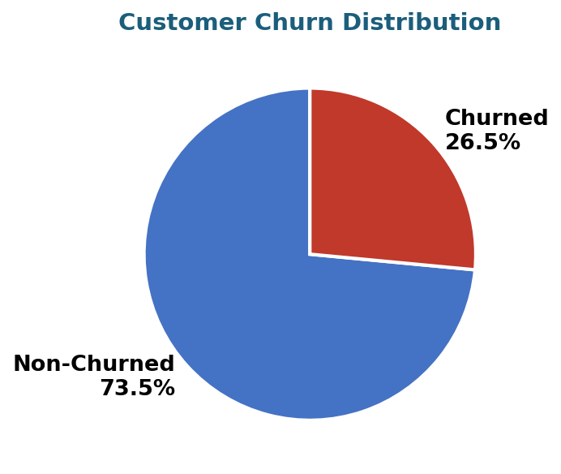
Measure Phase: Dataset Overview
Dataset: Cleaned Telco Customer Churn Data Total Customers: 5,043 Features include:
Customer Churn Distribution
Customer Demographics (gender, senior citizen, dependents)
Service Usage (internet, streaming, tech support, security)
Billing (monthly charges, total charges, charges group)
Engineered: Tenure_Group, Charges_Group, Churn_Flag
Target Variable: Churn (Yes / No)
Churn Rate (%) = (1,336 / 5,043) × 100 = 26.5% | DPMO = (1,336 ÷ 5,043) × 1,000,000 = 264,922 |
Sigma Level = 0.8406 + √(29.37 − 2.221 ln(264,922)) = 2.12
Churn Rate: 26.5% → Indicates a serious retention concern. Dataset includes engineered features (Tenure_Group, Charges_Group) for deeper analysis.

Slide 8
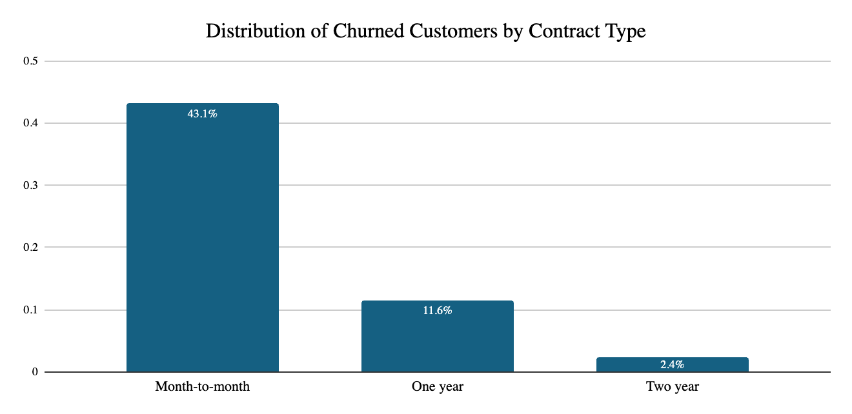
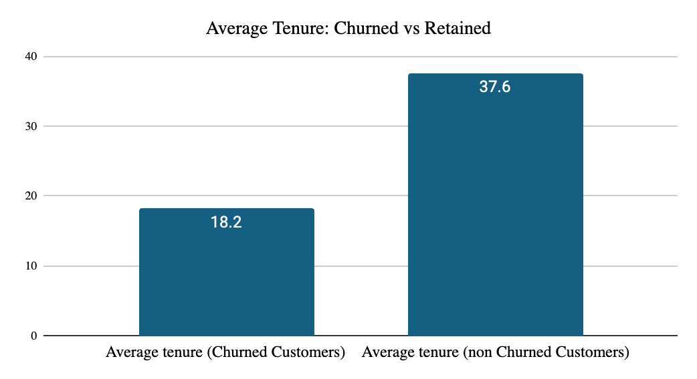
Measure Phase: Key Metrics & Insights
Churn Rate
Sigma Level
Avg Monthly Charges
26.5%
2.12 σ
$67.84
Month-to-month customers dominate churn (43.1%). Churned customers have significantly lower tenure (18.2 vs 37.8 months). These metrics establish the baseline for the Analyze phase.
Avg Charge (Churned) = $100,480 ÷ 1,336 = $75.21 , Avg Charge (Retained) = $251,882 ÷ 3,707 = $67.84 → Difference = +$7.37 (higher bills = more churn)

Slide 9
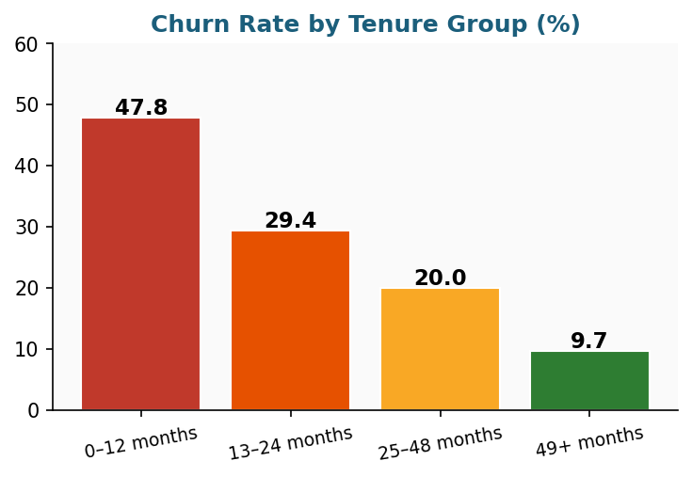
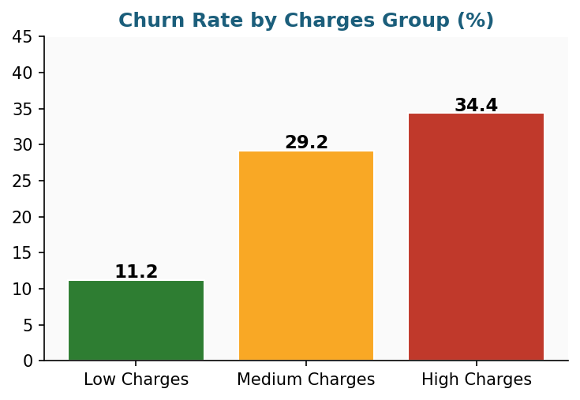
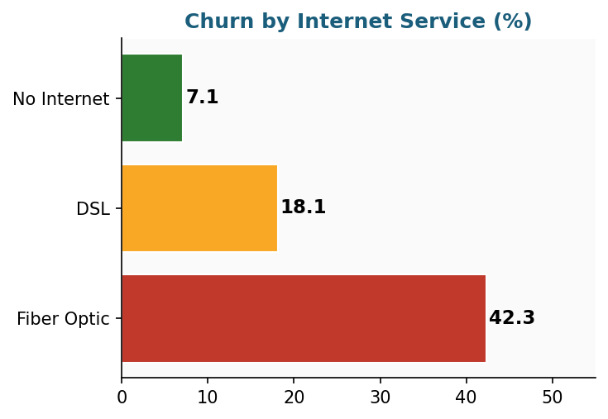
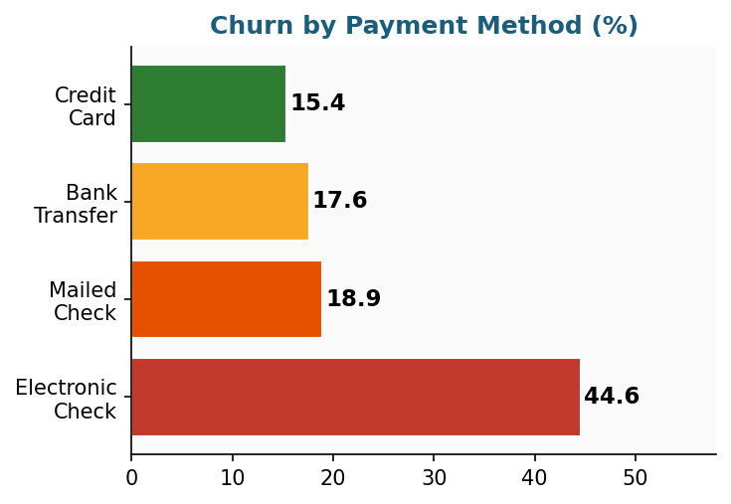
Analyze Phase: Exploratory Data Analysis (EDA)
Key EDA findings: 0–12 month customers churn at 47.8%. High charge customers churn at 34.4%. Fiber optic = 42.3% churn. Electronic check = 44.6% churn.

Slide 10
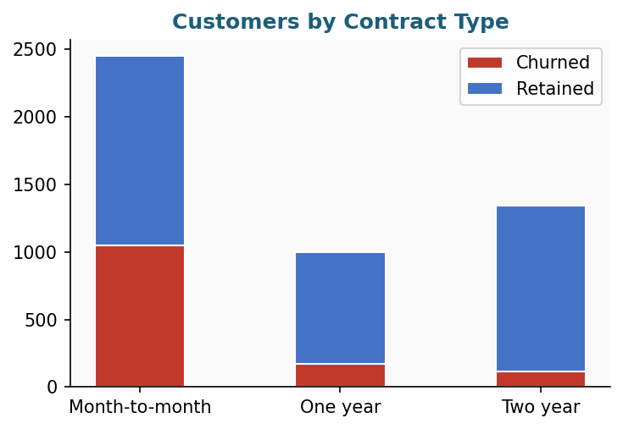
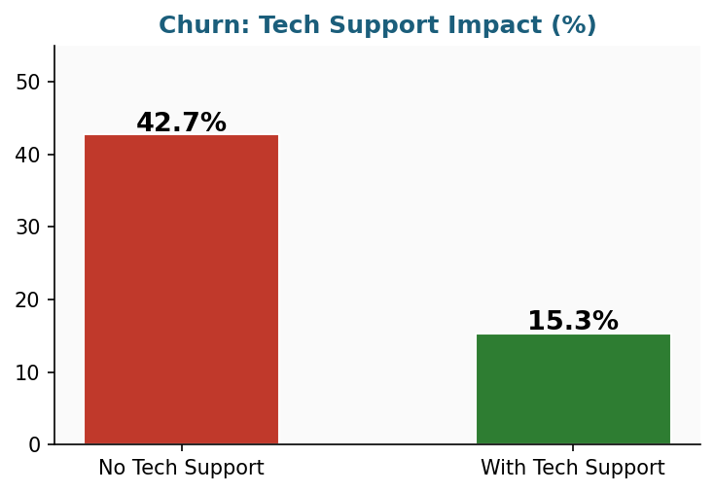
Analyze Phase: Churn Distribution by Key Segments
Month-to-month
Two-year contract
No tech support
With tech support
43.1% churn
2.4% churn
42.7% churn
15.3% churn
Month-to-month customers churn at 43.1% vs only 2.4% for 2-year contracts. Adding tech support reduces churn from 42.7% to 15.3% — a 27-point improvement.

Slide 11
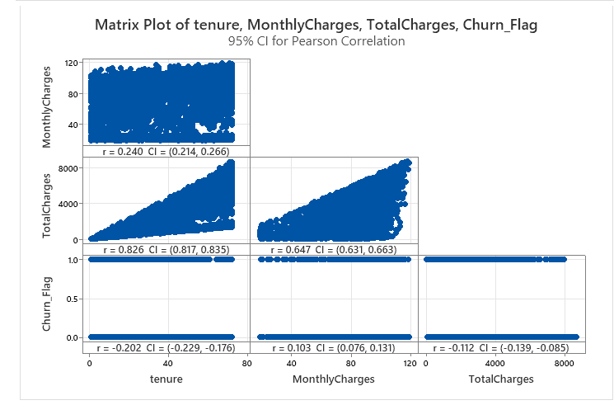
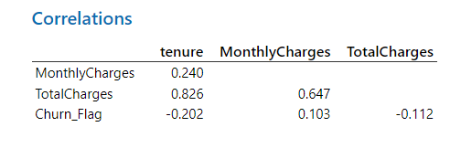
Analyze Phase: Correlation Analysis
•Tenure has a negative correlation (-0.20) with churn → longer customers are less likely to leave
•Monthly charges show a weak positive correlation (0.10) → higher charges slightly increase churn
•Total charges show a negative relationship (-0.11)
long-term customers churn less
•Overall correlations are weak but consistent with EDA findings

Slide 12
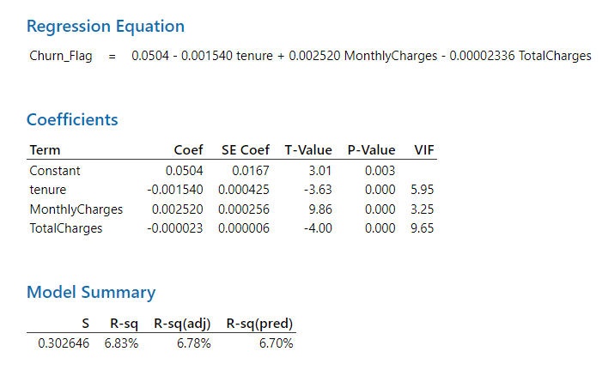
Analyze Phase: Regression Analysis (Linear Regression)
Title: Tenure
Coefficient: -0.0015
P-value: 0.00028 (significant) 👉 Negative effect → As tenure increases, churn decreases
Title: Monthly Charges
Coefficient: +0.0025
P-value: < 0.001 (significant) 👉 Positive effect → Higher charges increase churn
Title: Total Charges
Coefficient: -0.000023
P-value: significant 👉 Negative effect → Long-term/high-spending customers churn less
Linear regression provides initial insights; however, logistic regression is more appropriate as churn is a binary variable.

Slide 13
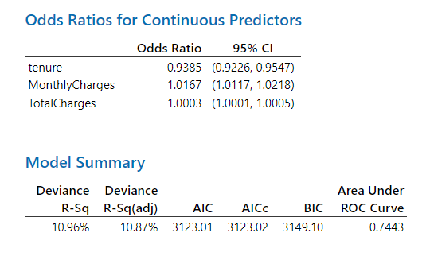
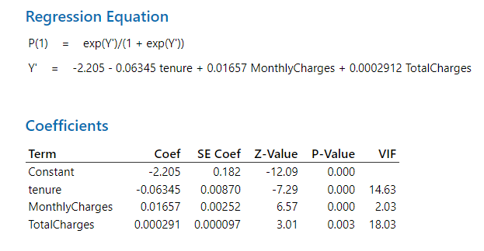
Analyze Phase: Logistic Regression Analysis
Which factors significantly influence customer churn?
Binary Logistic Regression was performed using Minitab since churn is a binary variable (Yes/No).

Slide 14
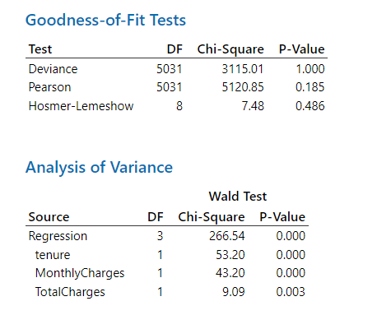
Analyze Phase: Logistic Regression Analysis
Binary Logistic Regression: Churn_Flag versus tenure, MonthlyCharges, TotalCharges
•Tenure reduces churn probability
•Monthly charges increase churn risk
•Month-to-month contracts significantly increase churn
•Lack of tech support increases churn
•Significant variables identified using p-values

Slide 15
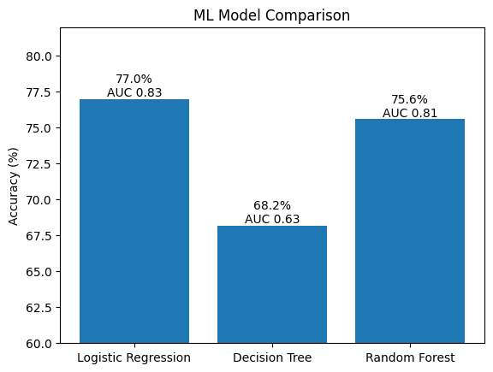
Analyze Phase: Predictive Dashboard & Future Research
Predictive Monitoring Dashboard
ML Model Comarison
🤖 Model:
Logistic Regression — 77% accuracy
📅 Frequency:
Runs monthly on all active customers
🚩 Flag:
Customers with churn probability > 70%
📞 Action:
Retention team contacts flagged customers
🎯 Goal:
Prevent churn BEFORE it happens
Decision Tree achieved 100% training accuracy but only 68.2% test accuracy, indicating overfitting. This is why Logistic Regression was selected as the preferred model
Future Research:
• Add XGBoost + deep learning for accuracy beyond 77% • Build real-time Python dashboard — deploy on GitHub • Publish DMAIC + ML framework in Sustainability (MDPI) journal
Our predictive dashboard prevents churn before it happens — not after. This project is the foundation for a published research paper. Thank you Professor Elahi and class!

Slide 16
Analyze Phase: Churn Prediction Using Machine Learning
ML Model Applied
Key Predictors Identified:
Logistic Regression:
77.0% accuracy
Contract Type (Month-to-month)
Tenure (0–12 months)
Payment Method (Electronic Check)
Monthly Charges (High spenders)
Decision Tree:
68.2% · AUC 0.63
Random Forest:
75.6% · AUC 0.81
Model Evaluation Insights:
Key Insight
Logistic Regression and Random Forest show consistent performance (~77%), while Decision Tree underperforms at 68% due to overfitting.
Indicates strong and stable patterns in customer behavior
No single model dominates → results are reliable and not random
Machine learning models confirm that customer churn is predictable and driven by identifiable behavioral and service factors.
Business Value of Prediction:
Prediction transforms churn analysis from reactive understanding to proactive prevention.
Enables early identification of high-risk customers
Supports targeted retention strategies
Reduces reactive decision-making
Prediction transforms churn analysis from reactive understanding to proactive prevention.

Slide 17
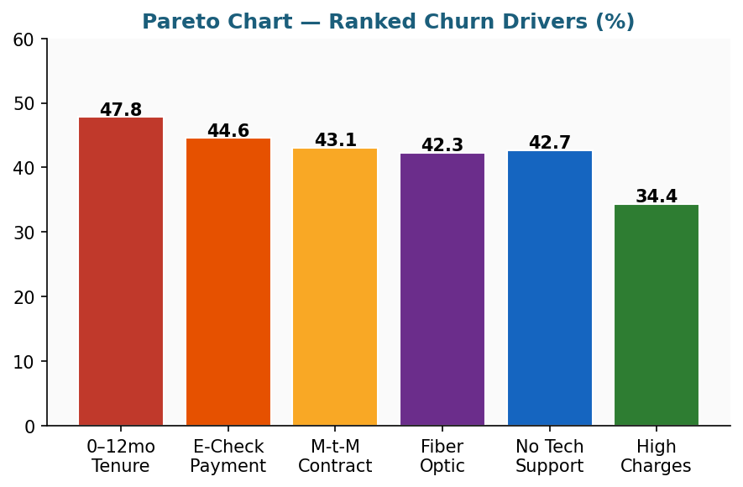
Analyze Phase: Root Cause Analysis & Key Findings
Fishbone (Ishikawa) Diagram
Pareto Chart — Ranked Churn Drivers
Effect: Customer Churn
Price
High monthly charges — churned avg $75.21 (+$14 vs retained)
Contract
Month-to-month = 43.1% vs 2-year = 2.4% churn
Service
Fiber optic = 42.3% churn — quality or price mismatch
Support
No tech support = 42.7% churn vs 15.3% with support
Payment
Electronic check = 44.6% vs credit card = 15.4%
Tenure
0–12 months = 47.8% churn — critical onboarding window
Pareto analysis: Top 3 drivers — Early tenure (47.8%), Electronic check (44.6%), Month-to-month contract (43.1%). These 3 alone explain majority of churn.

Slide 18
Improve Phase: Data-Backed Recommendations
Contract Upgrade Incentive
Auto-Pay Migration Incentive
Problem: Month-to-month = 43.1% churn
Problem: Electronic check = 44.6% churn
Fix: Offer 15–25% discount to switch to 1-year or 2-year contract within first 90 days
1,184 ÷ 2,744 = 43.1% (Month-to-month)
Fix: $5/month credit to switch to bank transfer or credit card auto-pay
758 ÷ 1,699 = 44.6% (E-check)
01
03
✓ 2-year contract churn = only 2.4%
✓ Credit card churn = only 15.4%
→ Largest lever — ~8–10 point churn reduction
30 ÷ 1,236 = 2.4% (2-year)
→ Huge difference = high churn driver
→ 3x reduction in payment-related churn
168 ÷ 1,089 = 15.4% (Credit card)
→ Auto-pay reduces churn ~3x
Early Tenure Onboarding
Tech Support Bundle
Problem: 0–12 months = 47.8% churn (highest risk)
Problem: No tech support = 42.7% churn
Fix: Proactive check-in calls at months 3, 6, and 9 with loyalty offers
733 ÷ 1,534 = 47.8% (0–12 months)
Fix: Include tech support free in all fiber optic plans
630 ÷ 1,474 = 42.7% (No support)
02
04
✓ 49+ month customers churn at only 9.7%
✓ With tech support → churn drops to 15.3%
→ Retain customers past critical 12-month window
156 ÷ 1,606 = 9.7% (49+ months)
→ Early customers are highest risk
→ 27-point churn reduction for fiber customers
111 ÷ 871 = 12.7% (With support)
→ Support reduces churn by ~30 pts
All 4 recommendations are directly backed by data from this dataset. Each targets the specific root cause confirmed in our Analyze phase.

Slide 19
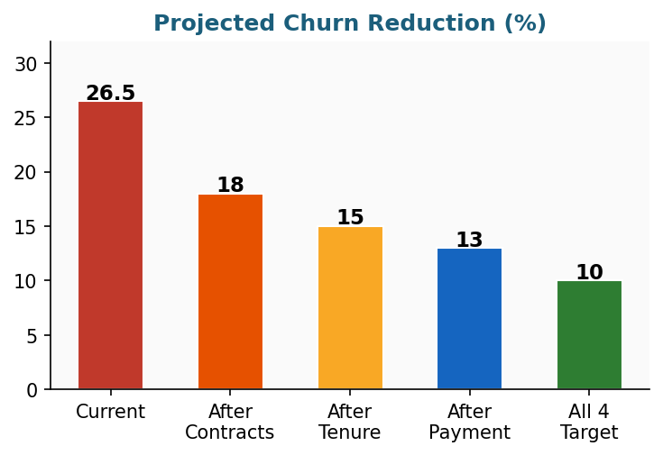
Improve Phase: Projected Impact & Sigma Improvement
Churn: Before
Churn: After
Sigma: Before
Sigma: After
26.5%
~10%
2.12 σ
2.78 σ
Before vs After Improvements
Projected Churn Reduction (%)
Metric
Before
After
Change
Churn Rate
26.5%
~10%
−16.5 pts
Customers Lost
1,336
~504
−832
DPMO
264,922
100,000
−164,922
Sigma Level
2.12
2.78
+0.66
Revenue Saved
—
$62,552/mo
+$63K
All 4 recommendations project churn dropping from 26.5% to 10% — improving sigma from 2.12 to 2.78 and saving approximately $62,552 per month in retained revenue.
New DPMO = (504 ÷ 5,043) × 1,000,000 ≈ 100,000 , New Sigma ≈ 2.78 → Improvement = +0.66 sigma

Slide 20
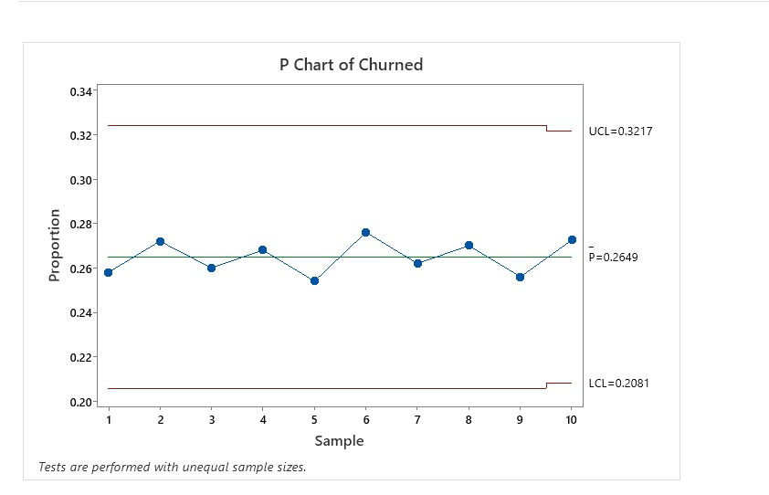
Control Phase: Monitoring Plan & KPIs
KPI 1
KPI 2
KPI 3
KPI 4
KPI 5
Monthly
Churn %
Sigma
Level
Avg Churn
Tenure
M-t-M
Contract %
E-Check
Usage %
Target: <10%
Target: 2.78+
Track <12mo
Decrease
Decrease
Control Plan (P-Chart in Minitab)
Monitor:
Monthly churn rate using P-Chart in Minitab
Response Plan if Churn Rises
UCL:
0.32 (Upper Control Limit)
Level 1 — Churn > 20%
Activate contract upgrade discount campaign immediately
Level 2 — Churn > 25%
Launch emergency retention program for all at-risk customers
Level 3 — Churn > 30%
Restart full DMAIC cycle from Define phase
The Control plan uses monthly P-Charts and a 3-level response plan to ensure improvements are permanent and churn does not revert.

Slide 21
Conclusion: Key Takeaways
What We Found
What We Achieved
Churn rate of 26.5% (1,336 customers) — sigma level 2.12
Month-to-month contracts: 43.1% churn vs 2-year: only 2.4%
First 12 months are critical — 47.8% churn in early tenure
Electronic check = 44.6% vs credit card = 15.4% churn
Chi-Square p = 0.000 — all findings statistically proven at 99.9%
ML models confirm churn is predictable — Logistic Regression achieves 77% accuracy
No tech support = 42.7% churn vs 15.3% with tech support
Model recall for churned customers is ~45% — future work will use class balancing (SMOTE) to improve detection of at-risk customers
Churn Rate:
26.5% → ~10% (target)
Sigma Level:
2.12 → 2.78 sigma
Revenue Saved:
$62,552/month
DPMO:
264,922 → 100,000
4 Data-Backed Recommendations:
Contract Upgrade Incentive (15-25% discount)
Early Tenure Onboarding (month 3, 6, 9 check-ins)
Auto-Pay Migration ($5/month credit)
Tech Support Bundle (free with fiber optic)
DMAIC + Machine Learning = A proven, data-driven framework to predict and reduce telecom customer churn.

Slide 22
Future Work & Research Directions
Beyond the scope of this ISE 250 project, we are interested in further developing this work into a real-world application
🤖
💻
📰
🌍
Advanced ML Models
Real-Time Dashboard
Journal Publication
Expand to Other Markets
Add XGBoost and Deep Learning to push accuracy beyond 78%
Build Python dashboard deployed on GitHub for live churn monitoring
Submit to Sustainability MDPI — open access, 6-8 week review
Test DMAIC+ML framework on other telecom markets and industries
Planned Journal Paper:
"Integrating DMAIC and Machine Learning for Customer Churn Prediction and Reduction in the Telecom Industry: A Statistical Process Control Approach"
Target: Sustainability MDPI (open access) | Extensions: XGBoost, real-time dashboard, GitHub deployment
Limitations of Current Study:
Dataset is historical (IBM Telco) — not real-time live data
ML accuracy capped at ~77% — advanced models (XGBoost, Neural Nets) may improve further
Recommendations are projections — real-world A/B testing needed to validate impact
Thank you — Professor Elahi and ISE 250 class! Questions welcome.

Slide 23
References
S.No | Research Paper | Author & Year
1 | Customer churn prediction in telecommunications | Bingquan Huang, Mohand Tahar Kechadi, Brian Buckley, 2012
2 | Defection Detection: Measuring and Understanding the Predictive Accuracy of Customer Churn Models | Scott A. Neslin, Sunil Gupta, Wagner Kamakura,and Charlotte H. Mason, 2006
3 | XGBoost: A Scalable Tree Boosting System | Chen & Guestrin, 2016
4 | New Insights into Churn Prediction in the Telecommunication Sector: A Profit Driven Data Mining Approach | Wouter Verbeke, Karel Dejaeger, David Martens, Joon Hur , Bart Baesens, 2012
5 | Developing optimization models for customer churn prediction in telecoms using artificial intelligence techniques | Ibrahim AlShourbaji, 2024
6 | Six Sigma Methodology Utilization in Telecom Sector for Quality Improvement- A DMAIC Process | BHARGAVA, MANISH, Dr. AWDHESH. BHARDWAJ, RATHORE A.P.S, 2010
7 | Six Sigma and continuous improvement strategies | Ghelani (2023)
8 | Customer Contentment and Churn Control in PTCL for Broadband (BB) services by means of Lean Six Sigma (LSS) | Sarrosh Zaheer, Shahzada Alamgir Khan, Umair Ashraf Khawaja, 2024
9 | Aligning key performance indicators with lean management in the service sector: A case study for a Jordanian telecommunication company | Abdullah Alalawin, Ahmad M. Qamar, Wafa’ H. AlAlaween, Yasser Bentahar, Tarneem Al-Halaybeh, Salsabeel Al-Jundi & Moayad Tanash, 2022
10 | Customer Churn Prediction: A Systematic Review of Recent Advances, Trends, and Challenges in Machine Learning and Deep Learning | Mehdi Imani, Majid, Joudaki, Ali, Hamid Reza, 2025

